Slide 1
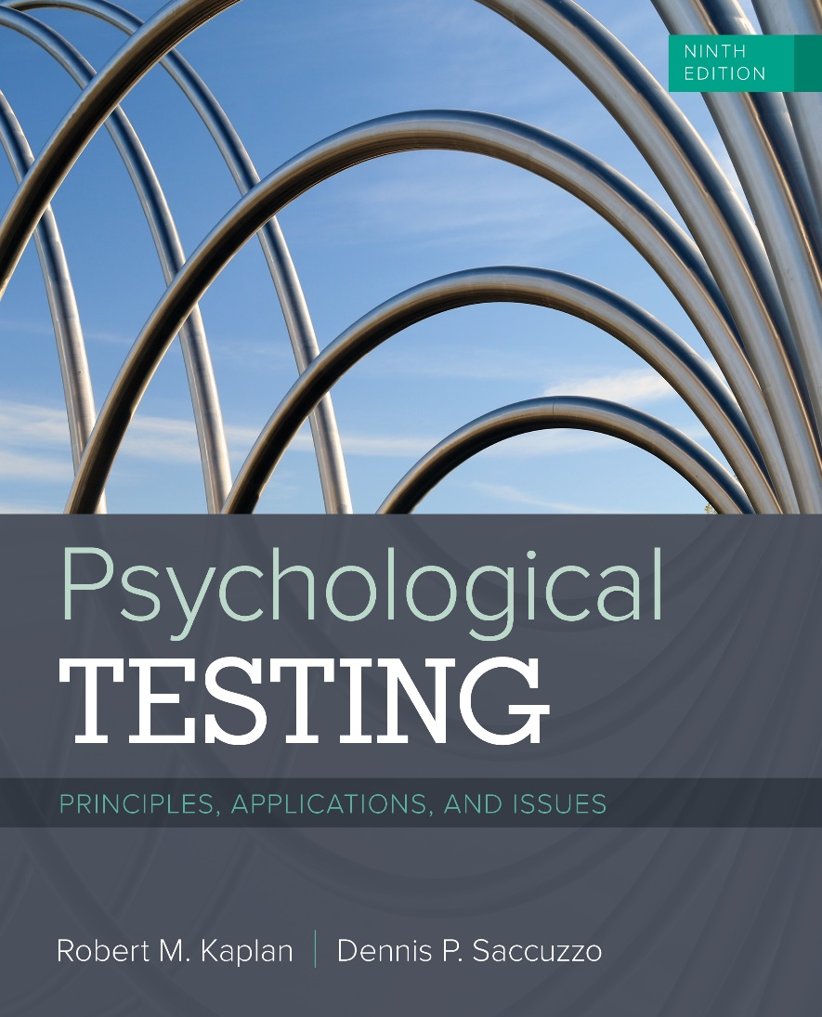

Psychological Testing
Ninth Edition
Chapter 16
Testing in Counseling Psychology
© 2019 Cengage. All rights reserved.

Slide 2
Chapter Outline (1 of 2)
Measuring Interests
  The Strong Vocational Interest Blank
  The Evolution of the Strong Measures
  The Campbell Interest and Skill Survey
  The Reemergence of the Strong Interest Inventory
  The Kuder Occupational Interest Survey
  The Career Assessment Inventory
  The Self-Directed Search
  Eliminating Gender Bias in Interest Measurement
  Aptitudes and Interests

Slide 3
Chapter Outline (2 of 2)
Measuring Personal Characteristics for Job Placement
  Are There Stable Personality Traits?
  Other Uses of Interest Matching Methods: The Case of Internet Dating

Slide 4
Learning Objectives
Describe the use of the criterion-keying method in the development of the SVIB
List some of the criticisms of the SVIB and how they were addressed in later versions of the measure
Describe how the KOIS differs from the SII
Outline some of the controversial issues in interest measurement
Evaluate the proposition that personality traits are stable over time
Discuss the newer uses of matching interest profiles, including Internet dating

Slide 5
Measuring Interests
Assessing interests is important for selecting an appropriate career
The first such measure was the Carnegie Interest Inventory (1921)
Mental Measurements Yearbook of 1939 discussed 15 different interest measures
One of the most widely used is the Strong Vocational Interest Blank, which has undergone many iterations over the years

Slide 6
The Strong Vocational Interest Blank
Developed after World War I by examining the activities that workers in different professions liked
  Interest patterns and hobbies were common for those successful in various careers
Used the criterion-group approach and led to SVIB
Used nearly 400 items; 1966 revision keyed them to 54 occupations for men and 32 occupations for women
Predictive validity for job satisfaction was high
Studies found that interest patterns are stable over time and were established by age 17
Was later criticized for gender bias

Slide 7
The Evolution of the Strong Measures (1 of 2)
The original SVIB is no longer in use
Strong-Campbell Interest Inventory (SCII)—1974
  Merged some of the items from the original SVIB to overcome some of the gender bias for which original measure was criticized
Introduced Holland’s RIASEC personality factors
Research has found strength in this model
  Describing work activities
  General training requirements
  Occupational rewards

Slide 8
The Evolution of the Strong Measures (2 of 2)
TABLE 16.1 Holland’s Six Personality Factors
Factor | Interest pattern
Realistic | Enjoys technical material and outdoor activities
Investigative | Is interested in science and the process of investigation
Artistic | Enjoys self-expression and being dramatic
Social | Is interested in helping others and in activities involving other people
Enterprising | Is interested in power and political strength
Conventional | Likes to be well organized and has clerical interests
Adapted from J. L. Holland (1985).

Slide 9
The Campbell Interest and Skill Survey
Intellectual ownership of the Strong-Campbell Interest Inventory, with two universities both claiming ownership
Campbell Interest and Skill Survey (CISS)—1992
  Yields different types of scales as well as an academic focus scale
  Also includes an extroversion scale to help assess comfort with jobs that have varying levels of interpersonal interaction
CISS was a continuation of the research on the SVIB and the SCII, and continues to use Holland’s personality types (RIASEC)

Slide 10
The Reemergence of the Strong Interest Inventory (1 of 3)
Stanford University released the updated Strong Interest Inventory (SII) in 2007
  Revised previous measure and used a new item format (five-choice, Likert-type scale)
  Contains 41 content areas to reflect changes in the workplace and a total of 244 occupational scales
  Used a new normative group and addressed gender bias in certain occupational domains
The SII has substantial concurrent validity for a variety of college major choices

Slide 11
The Reemergence of the Strong Interest Inventory (2 of 3)
TABLE 16.3 Scores on Occupational Themes for Jean A at Ages 28, 39, and 56
Theme | 1980, Age 28 | 1991, Age 39 | 2008, Age 56
Investigative | 58 | 58 | 69
Artistic | 51 | 51 | 56
Social | 45 | 46 | 60
Enterprising | 42 | 37 | 43
Conventional | 37 | 44 | 54
Realistic | 36 | 36 | 50

Slide 12
The Reemergence of the Strong Interest Inventory (3 of 3)
TABLE 16.4 Scores on Occupational Scales for Jean A at Ages 28, 39, and 56
Profession | 1980, Age 28 | 1991, Age 39 | 2008, Age 56
Physician | 58 | 53 | 48
Optometrist | 52 | 47 | 51
Psychologist | 50 | 47 | 57
University professor | 49 | 50 | 56

Slide 13
The Kuder Occupational Interest Survey
Second in popularity to the Strong Interest Inventory
Presents triads that must be ranked from most to least preferred alternative and provides data on 10 general occupational interests
Compares answers with those in different occupations
  Has a separate set of scales for college majors
Addresses nontraditional occupations for men and women
Four sections of each report
Very good psychometrics, with indications of interest stability similar to those in the Strong measures
Jackson Vocational Interest Survey (1995)

Slide 14
The Career Assessment Inventory
The CAI is designed to assess those who are not interested in careers that require college or other professional training
Written at the sixth-grade level and is designed for those with fewer than 4 years of postsecondary education
Similar to other measures discussed; utilizes the Holland structure
Uses 89 occupational scales
Desirable psychometric properties and scores/interests tend to be quite stable over time

Slide 15
The Self-Directed Search
Designed by John Holland himself to be self-administered, self-scored, and self-interpreted
Linked to an occupational finder, which provides access to over 1300 occupations based on matching one’s interest codes with those of careers
Psychometrics are adequate but “not high” in finding association between SDS categories and stated vocational aspirations
Can be assisted by computers if needed

Slide 16
Eliminating Gender Bias in Interest Measurement (1 of 2)
Early interest inventories discriminated against women
  They contributed to pushing both women and men into gender-typed occupations
In response test developers began using the same forms for women and men
Do men and women truly have different general interests, or does this reflect testing bias?
By using more representative normative samples, gender bias has been reduced but not eliminated

Slide 17
Eliminating Gender Bias in Interest Measurement (2 of 2)
Ongoing gender bias has been observed in different cultures.
How have interest inventories noted the differences in the interests of groups over time?
Studies have examined these changing trends:
  Between 1976 and 2004, college women have shown an increase in enterprising occupations, while college men have shown a decrease in Realistic and Investigative interests
Differences between men and women have decreased over the decades

Slide 18
Measuring Personal Characteristics for Job Placement
It is important that one’s interests be considered on their way to selecting a career path
It is also necessary to match an individual’s skills to the demands of a given job
Finding the right match can save frustration for the individual and wasted time and resources for the hiring company

Slide 19
Are There Stable Personality Traits?
It is an assumption of many that knowing a person’s traits will give information about how that individual will behave in the future
This is a common feature of all of the measures in this chapter, that is, they assume stability
  Research has provided support for this assumption
Others (see Mischel, 1984) suggest that this assumption is not as accurate as it may appear and that situations interact with traits to determine behaviors

Slide 20
Other Uses of Interest Matching Methods: The Case of Internet Dating
The same algorithms that can match people to jobs can match people to people!
Many have used or considered using an Internet dating service or have gone on a date with someone they met online
  Many end in long-term relationships or marriages
  Many note that such methods are a good way to meet a partner
With which online dating programs are you familiar?
Drawbacks to these services
  Matching methods are unavailable to the public

